Slide 1
An Intense Northern Michigan Snow Event – 8 March 2009
John Boris -- National Weather Service, Gaylord MI
Great Lakes Operational Meteorology Workshop -- March 2010

Slide 2
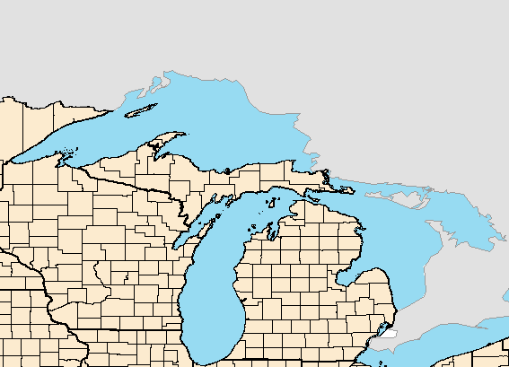
Introduction
Area of Interest:
Event Time Frame: ~ 2100Z 8 March – 0900Z 9 March 2009
-- Synoptic scale run-up to the event
-- “The Event”

Slide 3
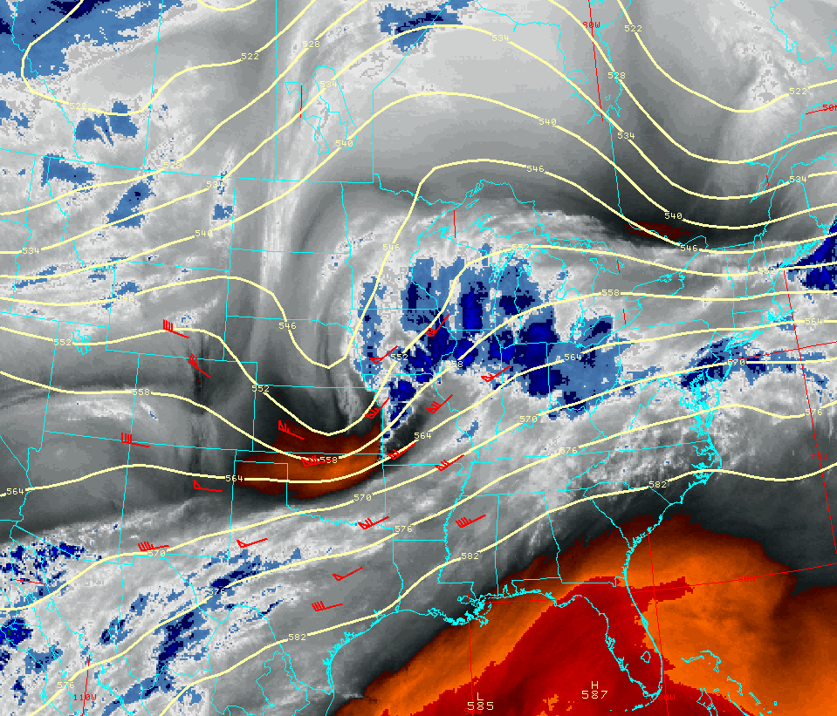
Synoptic Overview
Water Vapor Image/500mb Heights and Profiler Winds: 12Z 8 Mar 2009
Notes:
500mb heights/water vapor: 12z 8 Mar 2009. Split flow with southern branch short wave trough emerging from central/southern Rockies...across the central High Plains at 12z. Another short wave trough in the northern branch just clipped Lake Superior…with northern stream height falls across Quebec and northern New England.

Slide 4
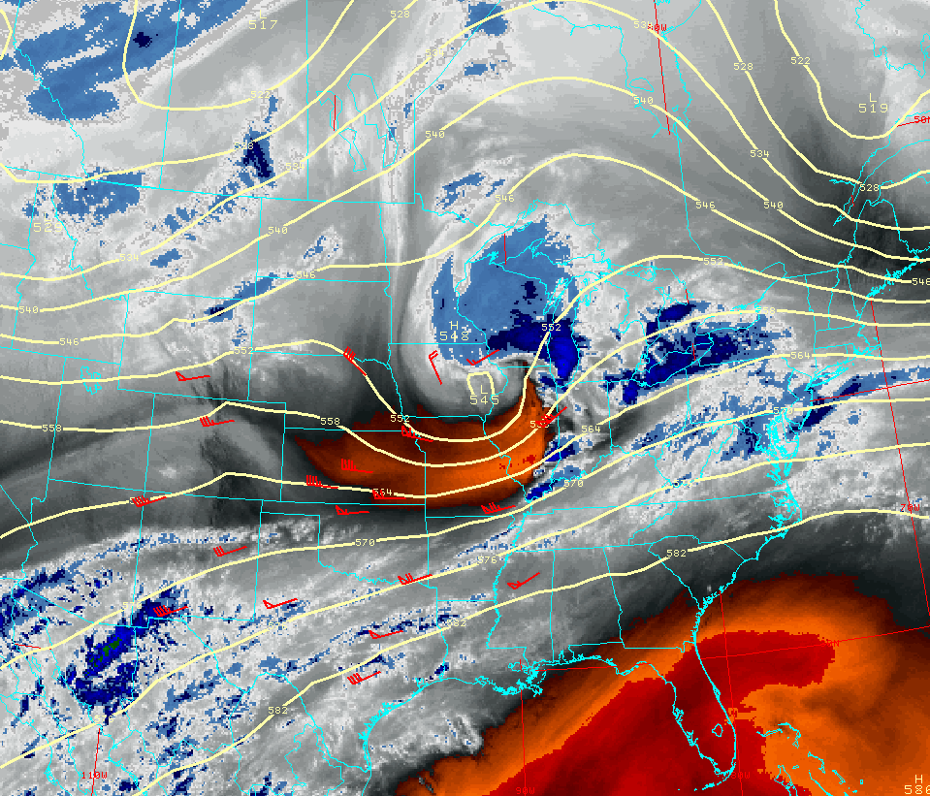
Synoptic Overview
Water Vapor Image/500mb Heights and Profiler Winds: 18Z 8 Mar 2009
Notes:
500mb heights/water vapor: 18z 8 Mar 2009. Short wave continues to strengthen as it crosses Iowa...combination of cold advection into the backside of the trough and a reduction in wavelength downstream contributing to wave deepening.

Slide 5
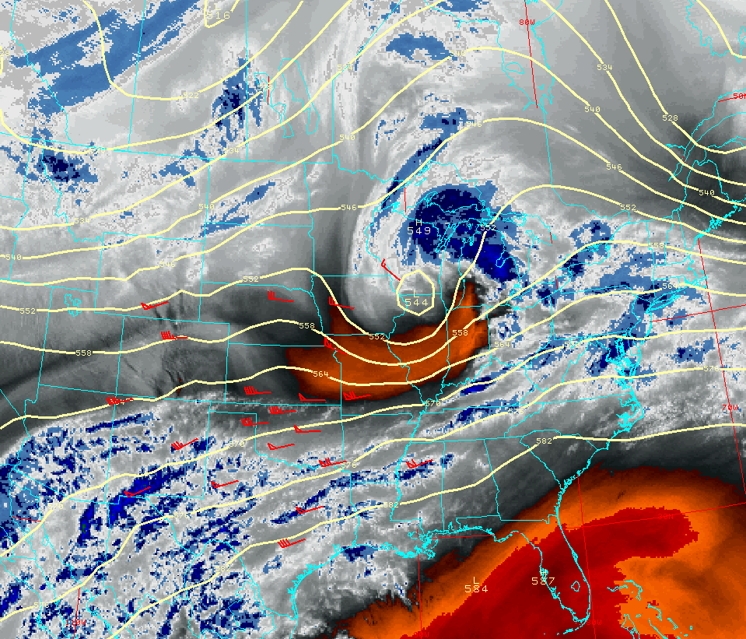
Synoptic Overview
Water Vapor Image/500mb Heights and Profiler Winds: 21Z 8 Mar 2009
Notes:
500mb heights/water vapor: 21z 8 Mar 2009. Compact wave along Wisconsin/Illinois border. Precipitation spreading into northern Michigan with dry slot rounding the base of the short wave and punching into southwest Lower Michigan.

Slide 6
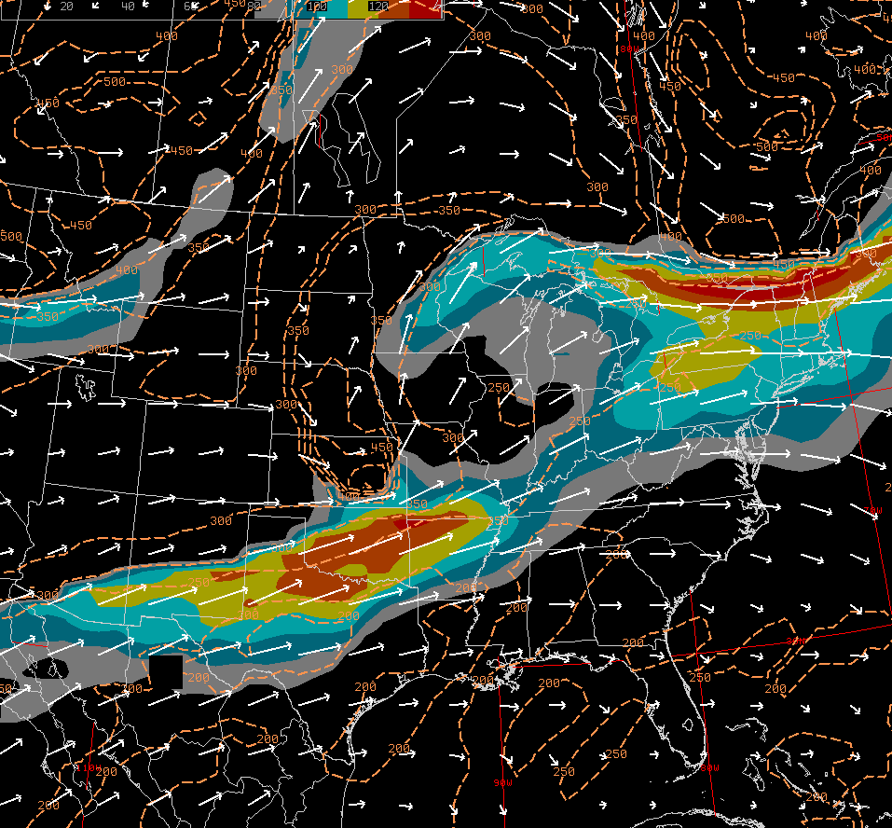
Synoptic Overview
1.5 PVU Surface – Isotachs (>80kt/10kt Increments) and Pressure (dashed): 12Z 8 Mar 2009
X
X
Notes:
1.5 PVU pressure/isotachs: 12z 8 Mar 2009. A view of the system from a different perspective. Jet analysis using winds on dynamic tropopause. Broadly difluent flow into the mid/upper Mississippi valley. Some hints of a coupled jet structure between northern and southern branch jet streaks.

Slide 7
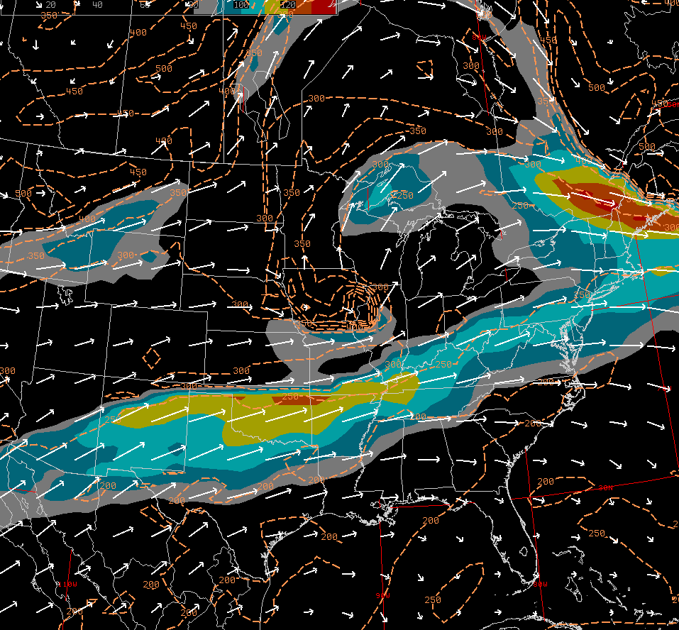
Synoptic Overview
1.5 PVU Surface – Isotachs (>80kt/10kt Increments) and Pressure (dashed): 18Z 8 Mar 2009
X
X
Notes:
1.5 PVU pressure/isotachs: 18z 8 Mar 2009. Continued difluent flow.

Slide 8
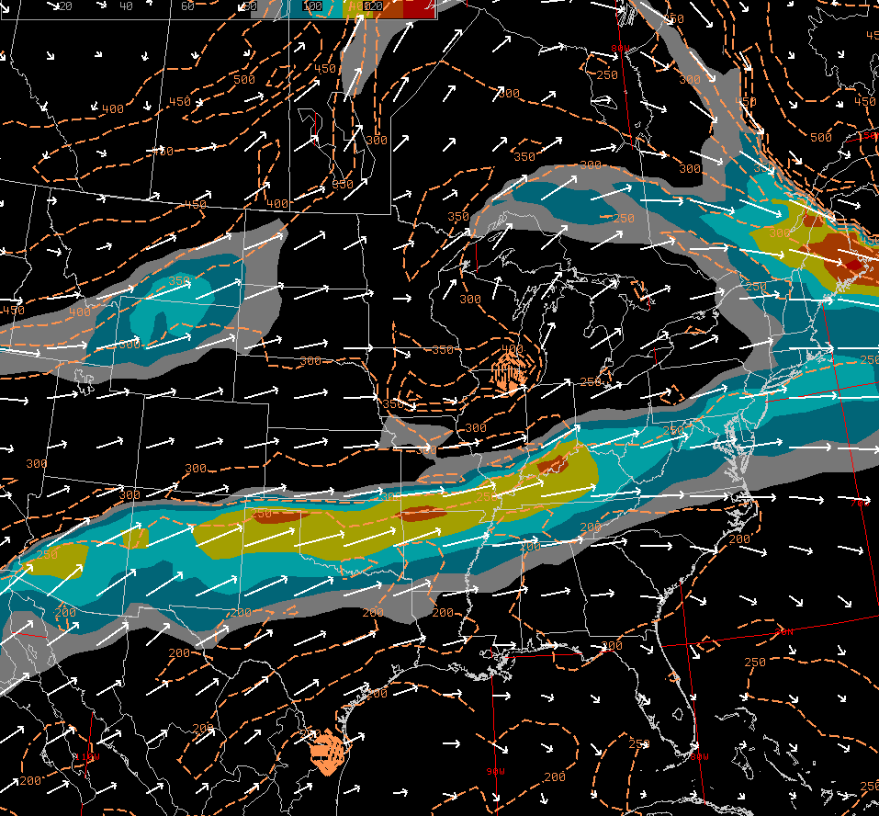
Synoptic Overview
1.5 PVU Surface – Isotachs (>80kt/10kt Increments) and Pressure (dashed): 21Z 8 Mar 2009
X
Notes:
1.5 PVU pressure/isotachs: 21z 8 Mar 2009. Still some hints of northern branch entrance region jet forcing across the upper Great Lakes.

Slide 9
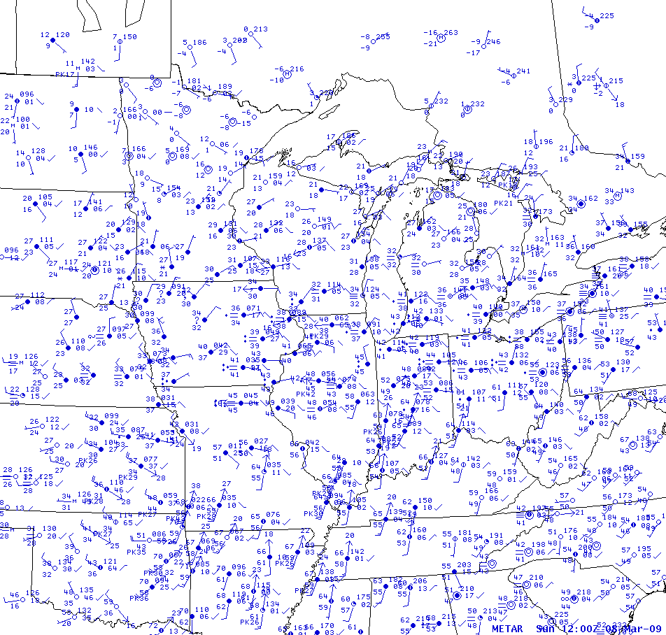
Synoptic Overview
Surface Analysis : 12Z 8 Mar 2009
12
16
20
24
H
26
24
20
0c
16
12
10c
04
10c
01
L
16
0c
08
15c
20
12
10c
12
16
20
10c
Notes:
Surface analysis: 12z 8 Mar 2009. Developing surface low across MO…strong baroclinic zone extends east across the Ohio River valley. Note cold/dry air emanating from surface high over Ontario…with a surge of low level moisture ahead of cold front approaching MO/AR.

Slide 10
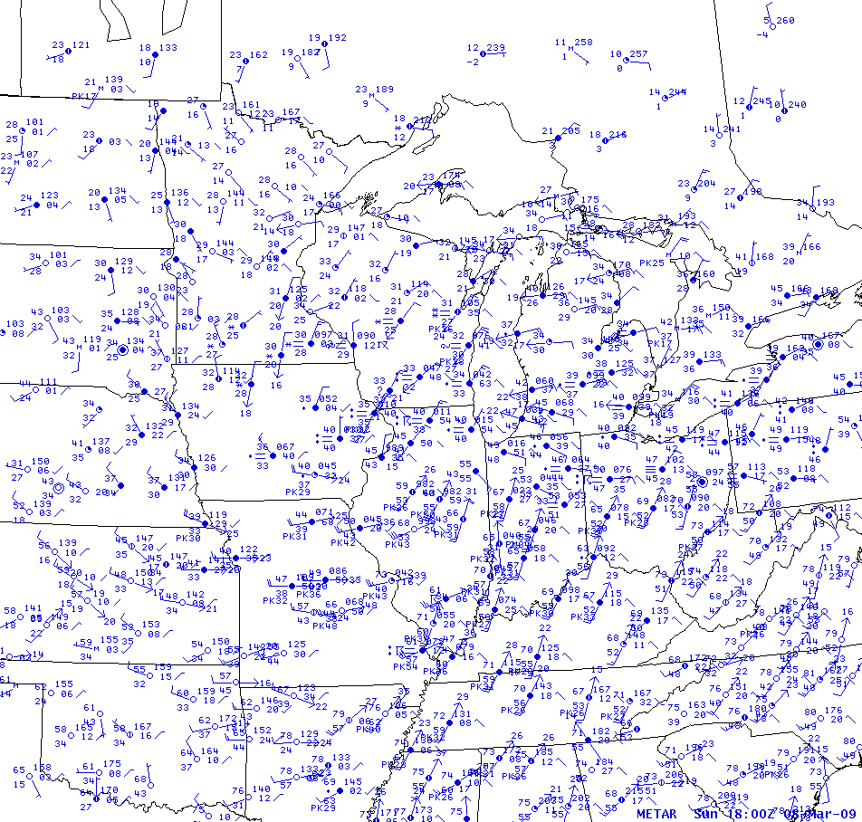
Synoptic Overview
Surface Analysis : 18Z 8 Mar 2009
16
20
24
12
24
20
0c
0c
16
08
04
12
97
00
12
L
10c
12
16
15c
16
16
10c
16
20
20
Notes:
Surface analysis: 18z 8 Mar 2009. Surface low deepens about 4mb/6h as it moves into IL. Warm air continue to make northward progress…surface temperatures across much of northern Lower Michigan have climbed above freezing…with 40 degree readings around TVC/FKS (aided by easterly downslope flow).

Slide 11
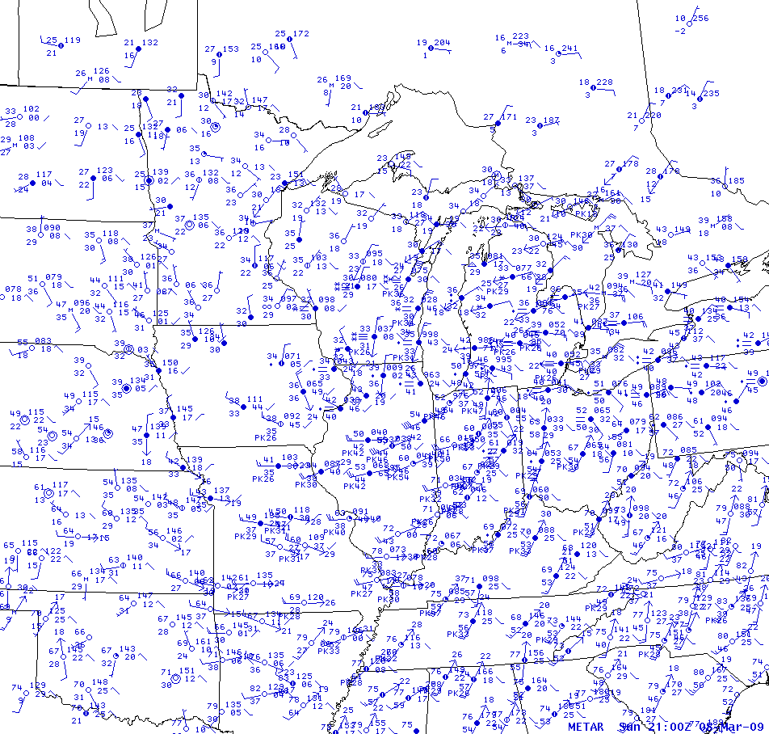
Synoptic Overview
Surface Analysis : 21Z 8 Mar 2009
12
16
20
24
24
20
0c
0c
16
0c
08
04
95
00
96
L
12
10c
10c
12
12
15c
10c
10c
Notes:
Surface analysis: 21z 8 Mar 2009. Surface low down to around 996mb as it moves into southern Lake Michigan. Low about to under occlusion as warm sector begins to move into southwest Lower Michigan. Temperatures falling across northern Michigan as precipitation spreads in from the southwest.

Slide 12
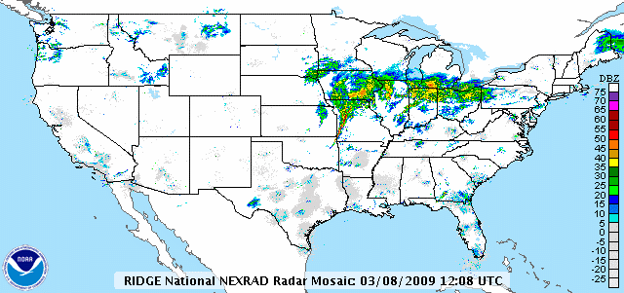
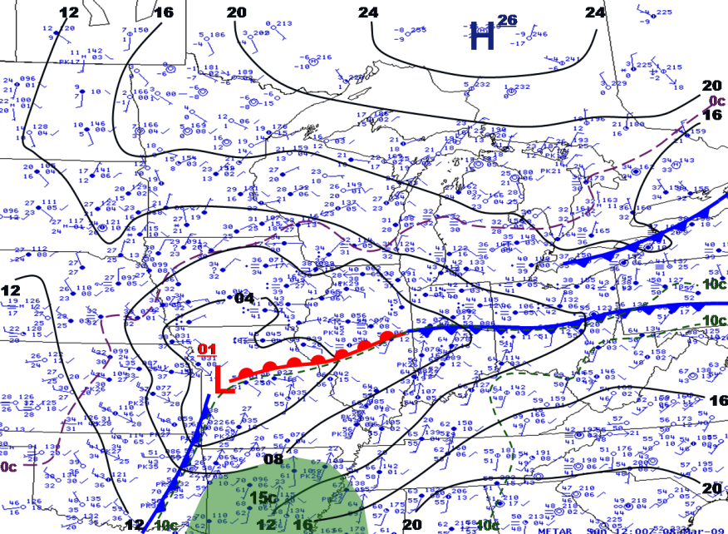
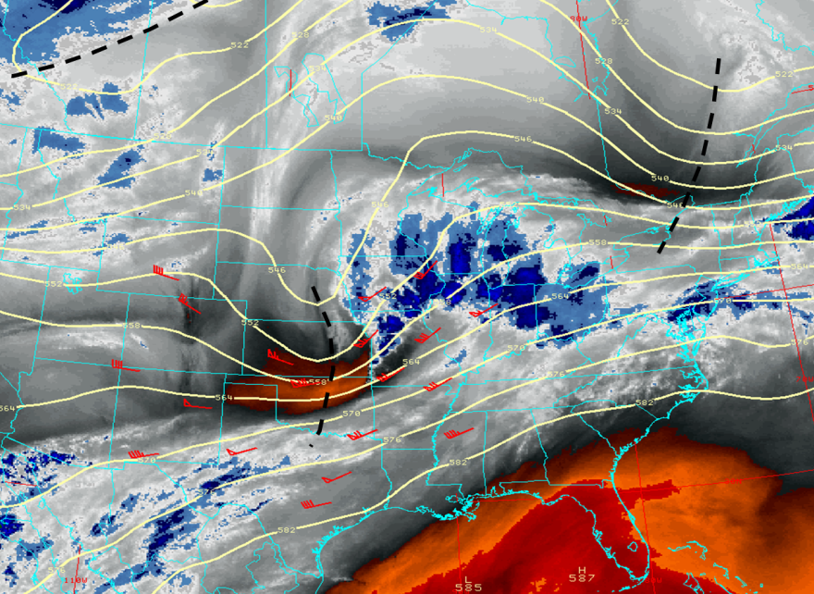
Synoptic Overview
12Z 8 March 2009
Notes:
National radar mosaic/surface analysis/500mb heights and WV: 12z 8 Mar. Precipitation expanding north of the warm front into IA/northern MO/northern IL. Squall line in warm sector across western MO.

Slide 13
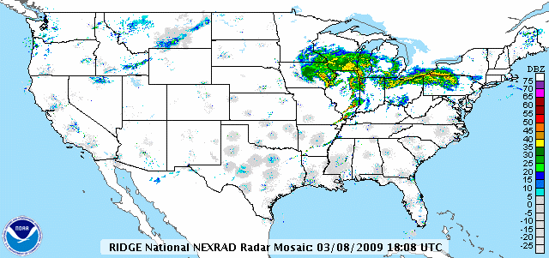
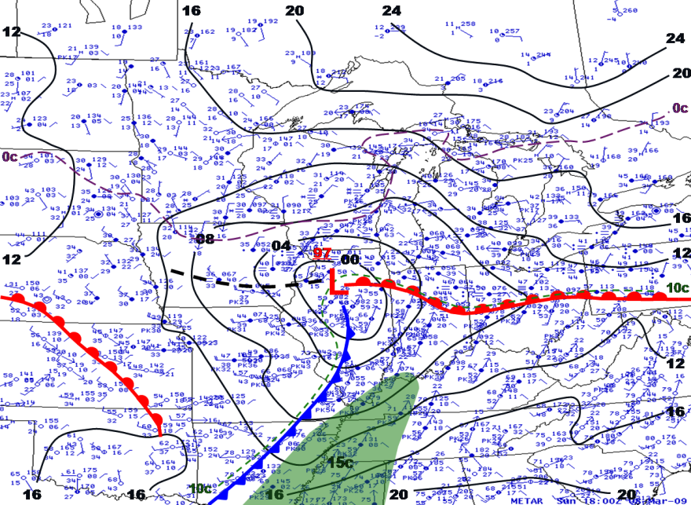
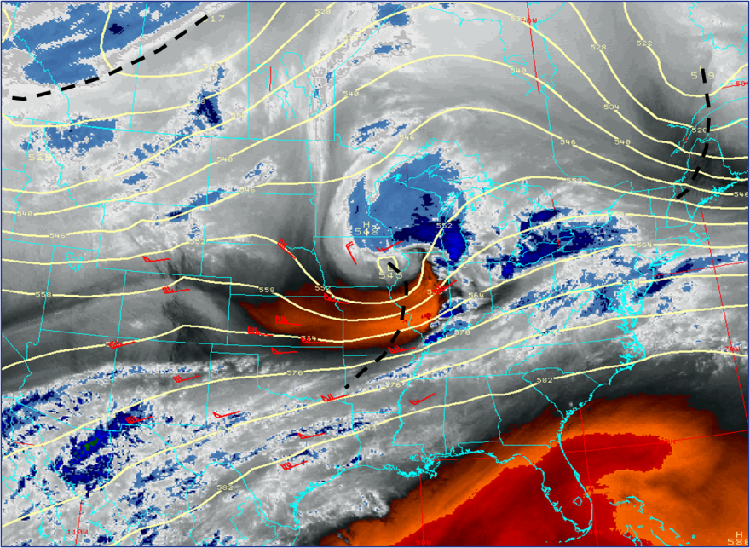
Synoptic Overview
18Z 8 March 2009
Notes:
National radar mosaic/surface analysis/500mb heights and WV: 18z 8 Mar. Short wave evident across southeast IA in WV and radar imagery…precip spreading into southern WI/southern Lake Michigan…with convection continuing ahead of cold front crossing IL/southeast MO/AR.

Slide 14
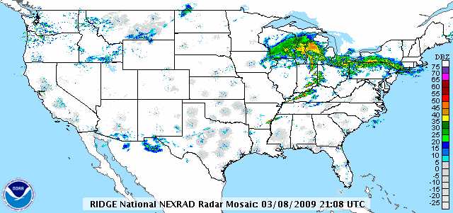
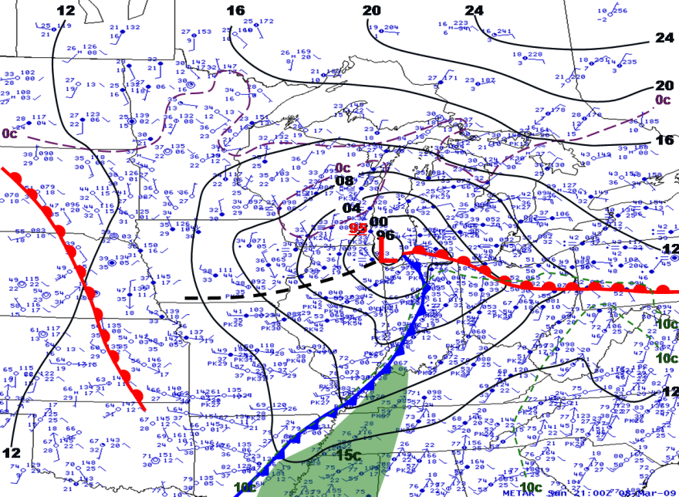
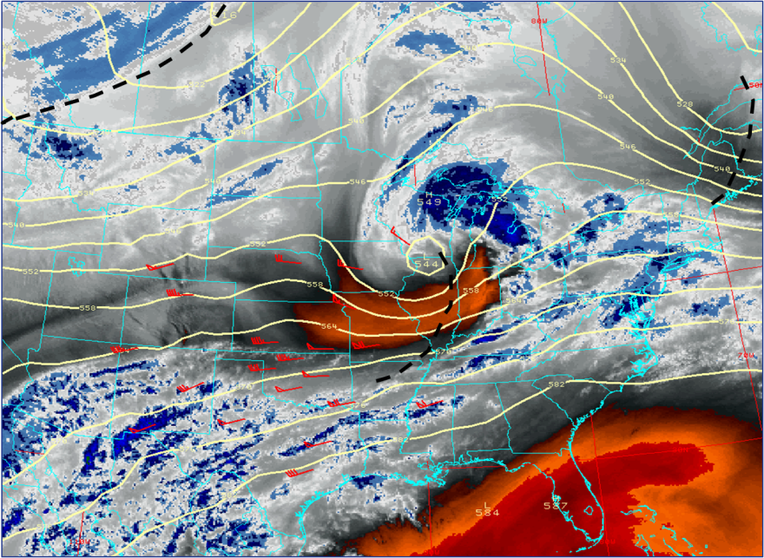
Synoptic Overview
21Z 8 March 2009
Notes:
National radar mosaic/surface analysis/500mb heights and WV: 21z 8 Mar. Precip spreading into western Lower Michigan as surface low moves into Lake Michigan. Dry slot punching up into southwest Lower Michigan as system begins to occlude.

Slide 15
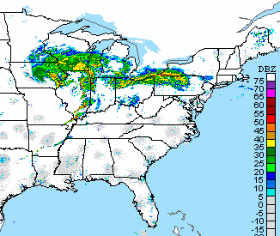
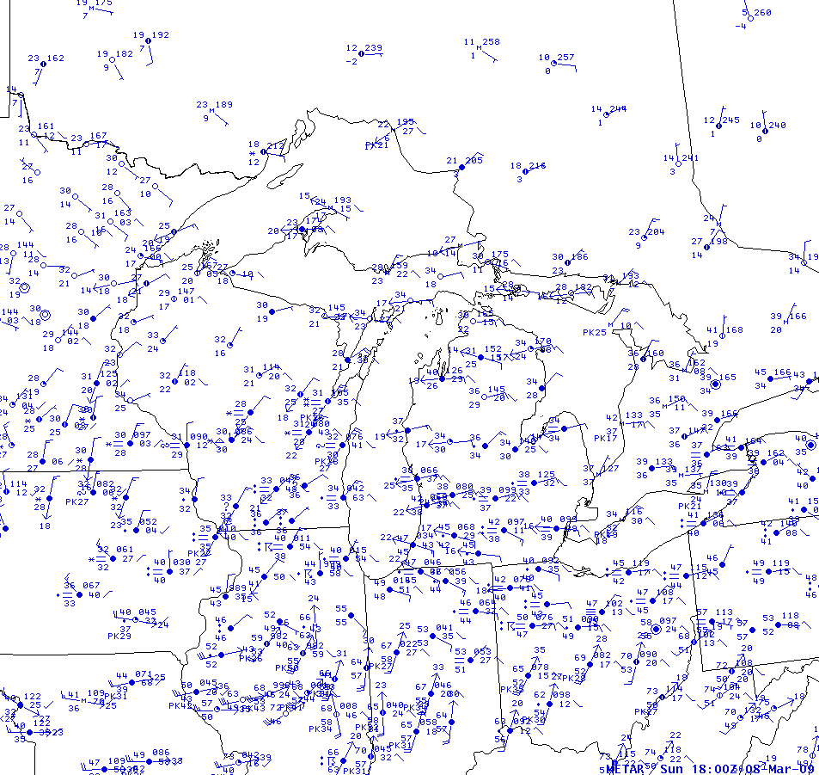
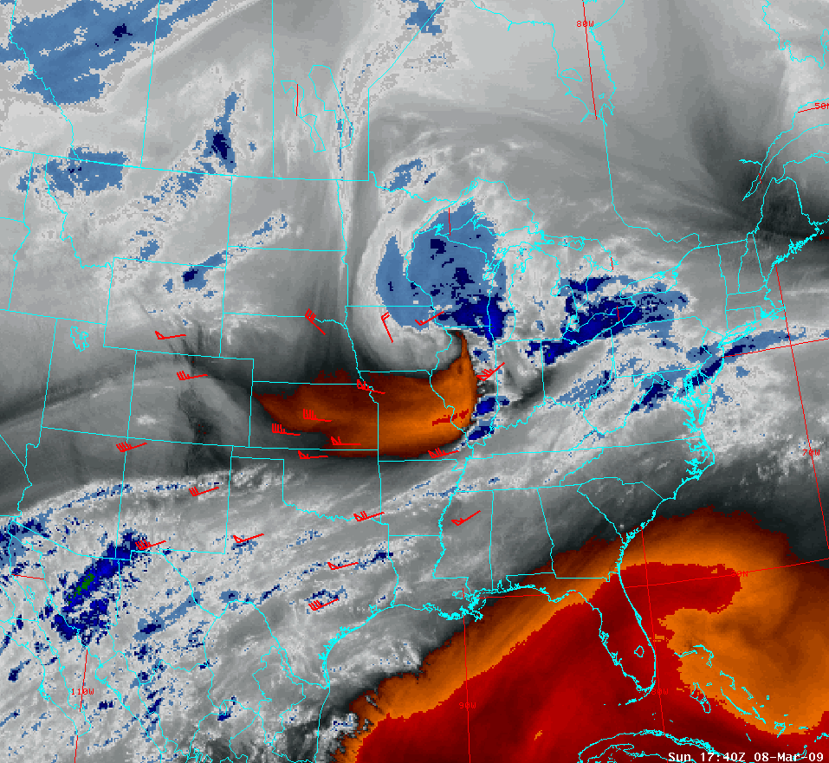
“The Event”
18Z 20Z 22Z 00Z 02Z 04Z
National Radar/Water Vapor
Surface Map
-10c
0c
-10c
0c
0c
0c
97
L
10c
15c
10c
10c
10c
Notes:
Moving onto a mesoscale look at the event itself. Starting with an 18z surface mesoanalysis. East/northeast flow of colder/drier air into northern Michigan…though temperatures across much of northern Lower are above freezing (40 degree readings from TVC west to Lake Michigan aided by easterly downsloping flow from higher terrain).

Slide 16
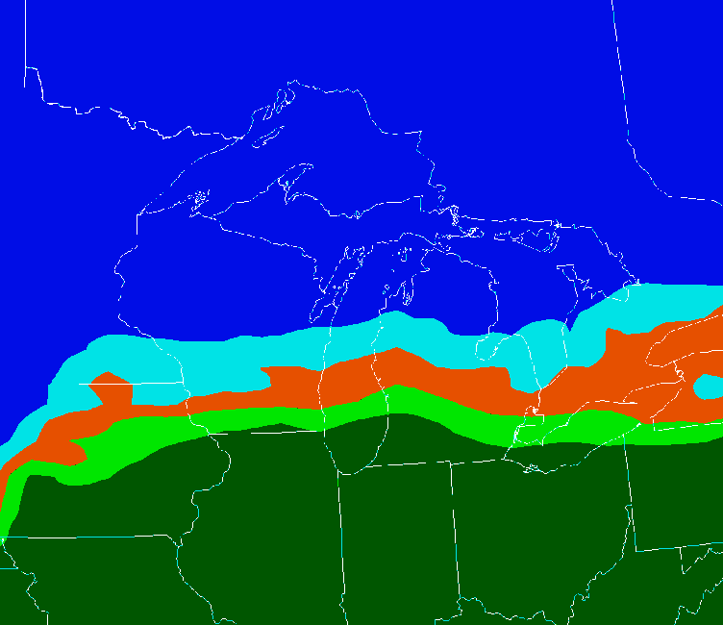
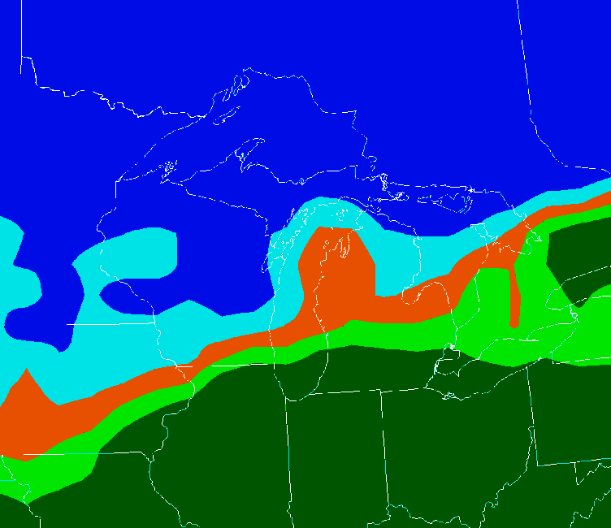
“The Event”
18Z 20Z 22Z 00Z 02Z 04Z
0-6km Layer Max Temperature
Surface Map
12Z
*
< 0c
0-1c
-10c
1-3c
0c
3-5c
-10c
> 5c
0c
18Z
0c
< 0c
0c
97
*
0-1c
L
1-3c
10c
3-5c
> 5c
15c
10c
10c
10c
Notes:
Precipitation type was one of the concerns going into this event...and how that would affect snowfall totals across areas that could see some rain on the front end of the event. Similar concerns to 26 February 2009 event...warm air surged north with some areas expected to receive heavy snowfall picking up a little snow and a lot of freezing rain. Will focus on area around Traverse City (marked with * on max temp maps), which was near center of heaviest snowfall.

Slide 17
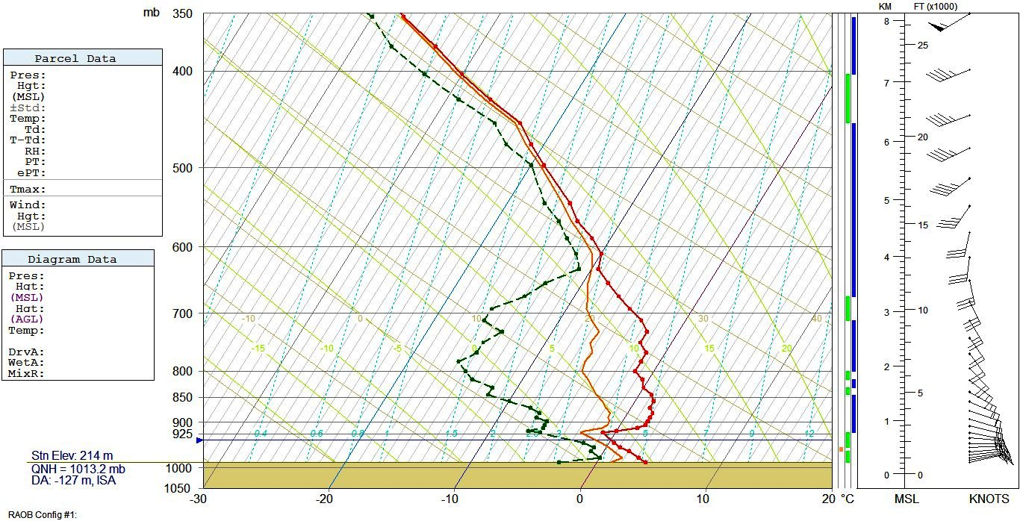
“The Event”
18Z 20Z 22Z 00Z 02Z 04Z
Forecast Sounding at Traverse City MI (TVC) : 18Z 8 Mar 2009
Red: Temperature
Green: Dew Point
Orange: Wet Bulb
0c
Notes:
18z forecast BUFR sounding data from Traverse City (TVC). Elevated warm layer about 2c in magnitude/100mb deep. Lots of dry air below 600mb, and plenty of room for evaporative cooling (wet bulb profile below zero above about 930mb).

Slide 18
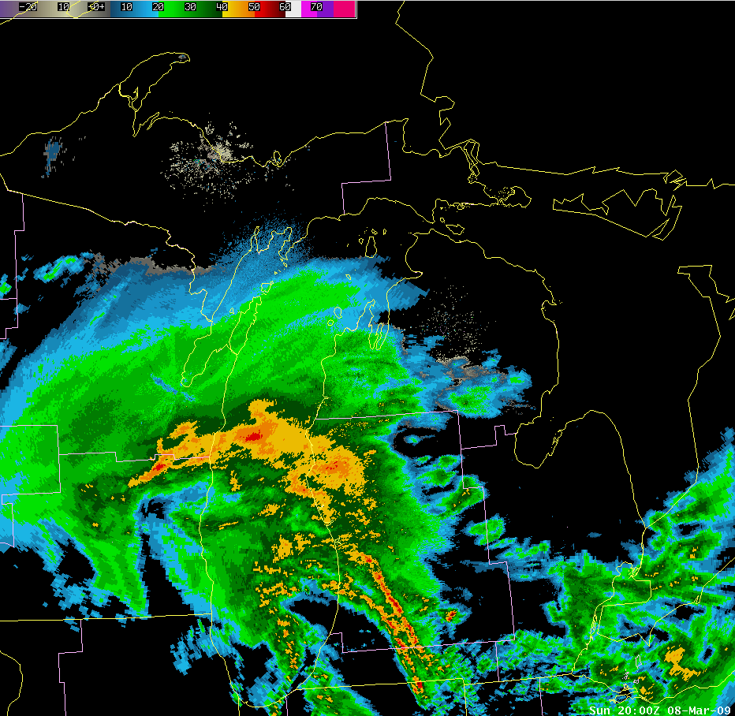
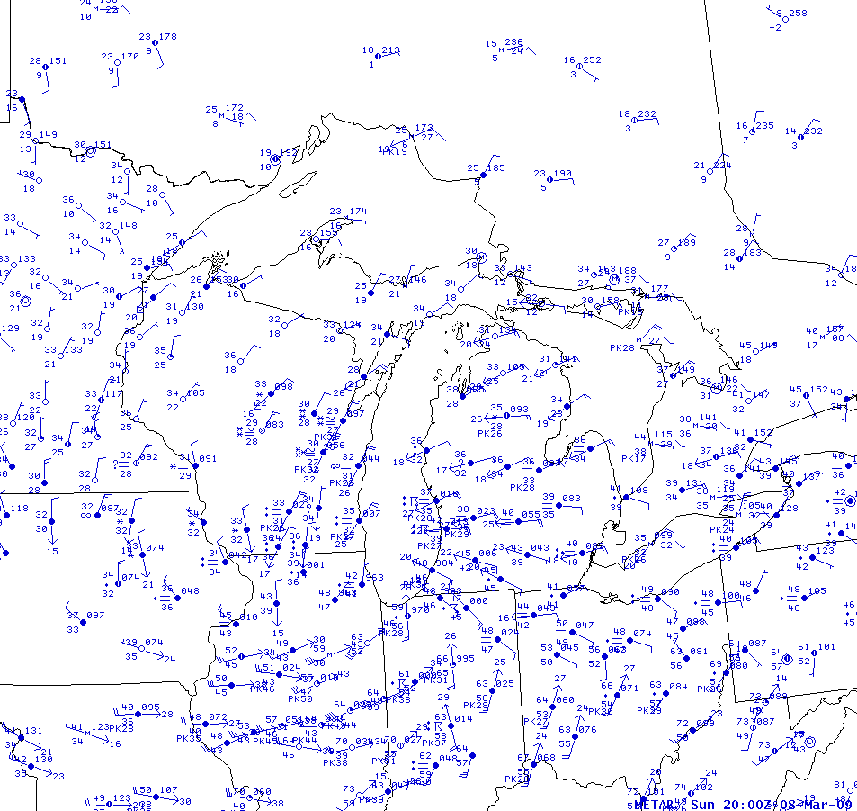
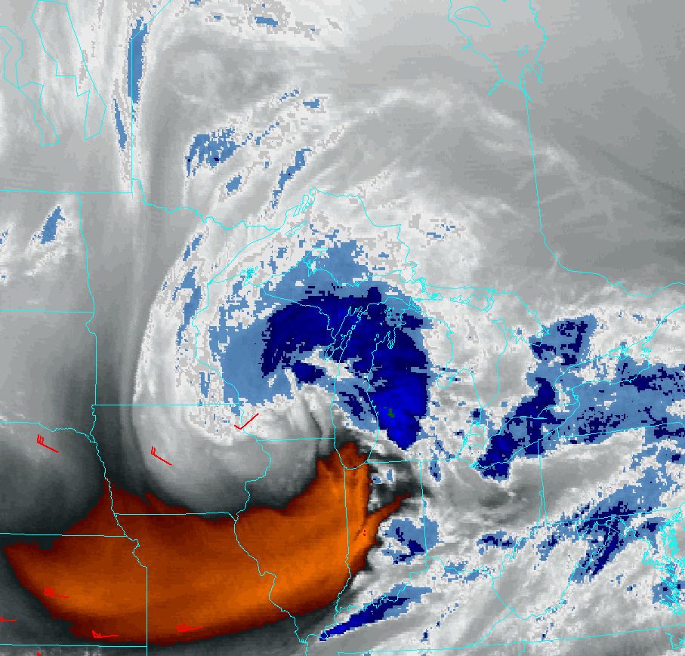
“The Event”
18Z 20Z 22Z 00Z 02Z 04Z
Regional Radar/Water Vapor
Surface Map
0c
-10c
-10c
0c
0c
96
0c
L
10c
15c
10c
10c
Notes:
20z Surface mesoanalysis/Radar 2000z/WV image 2002z. Precip starts to spread into northern Lower.

Slide 19
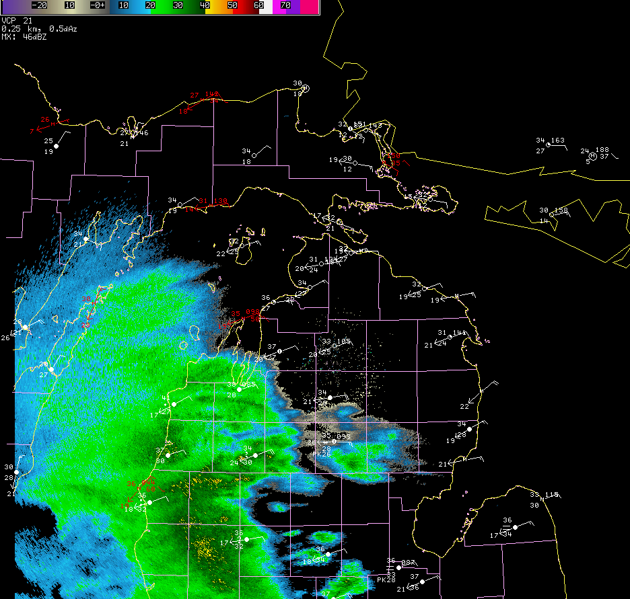
“The Event”
18Z 20Z 22Z 00Z 02Z 04Z
KAPX Reflectivity/Surface Observations
3c/-3c
3c/-2c
5c/-3c
1c/-2c
3c/-1c
1c/-1c
2c/0c
Notes:
Closer-in view of 2002z KAPX radar image plus surface observations. 41F and raining at FKS…37 at MBL…34 and -DZ at CAD.

Slide 20
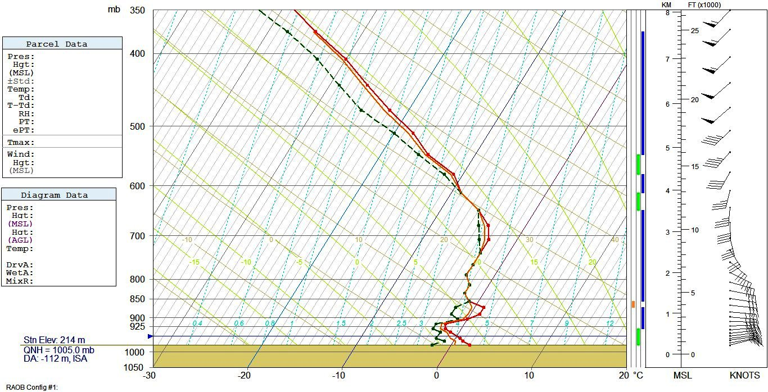
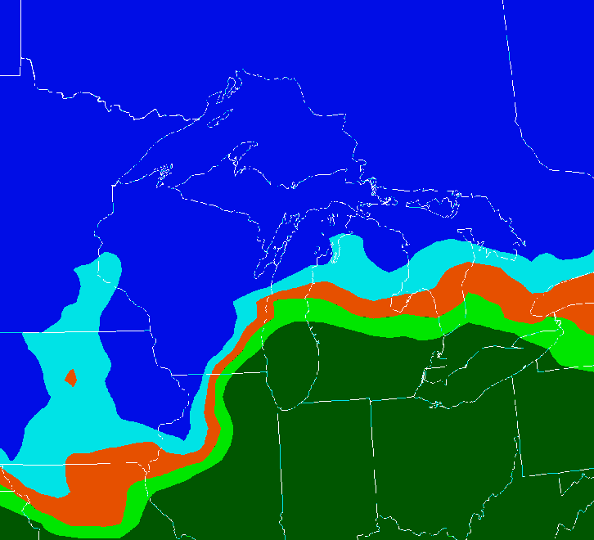
“The Event”
18Z 20Z 22Z 00Z 02Z 04Z
Forecast Sounding at Traverse City MI (TVC) : 21Z 8 Mar 2009
21Z
<0c
Red: Temperature
Green: Dew Point
Orange: Wet Bulb
< 0c
*
0-1c
1-3c
3-5c
> 5c
0c
KTVC 081953Z 07009KT 10SM BKN065 OVC200 03/M02 A2976
KTVC 082053Z 07011KT 2 1/2SM –PL OVC048 02/M02 A 2095 RMK RAB07E28SNB07E47PLB47
KTVC 082153Z 05008KT 1/2SM SN VV008 00/M01 A2977 RMK PLE2059SNB2059 P0011
Notes:
Forecast BUFR sounding data for Traverse City (TVC): 21z 8 Mar 2009. Warm layer shrinking (down to about 1c/40mb depth)…precip at TVC starts as mixed rain/snow (or perhaps more likely mixed rain/sleet)…goes to all sleet…then over to snow in a matter of about one hour.

Slide 21
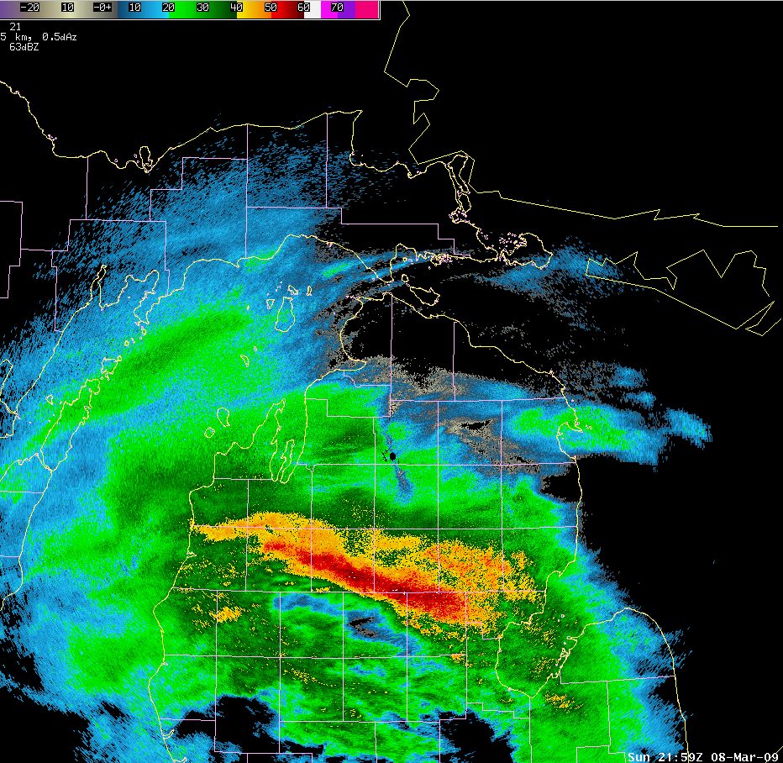
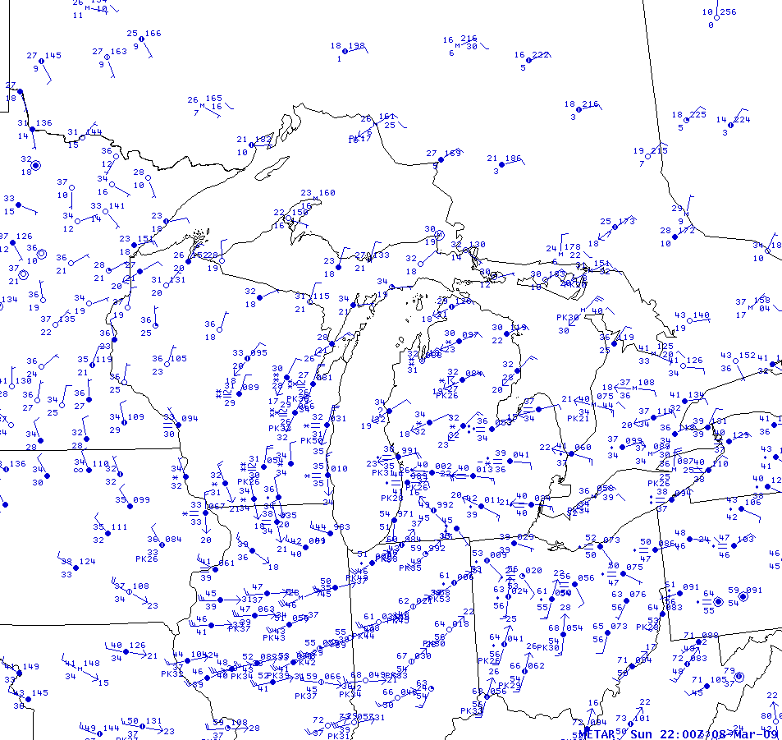
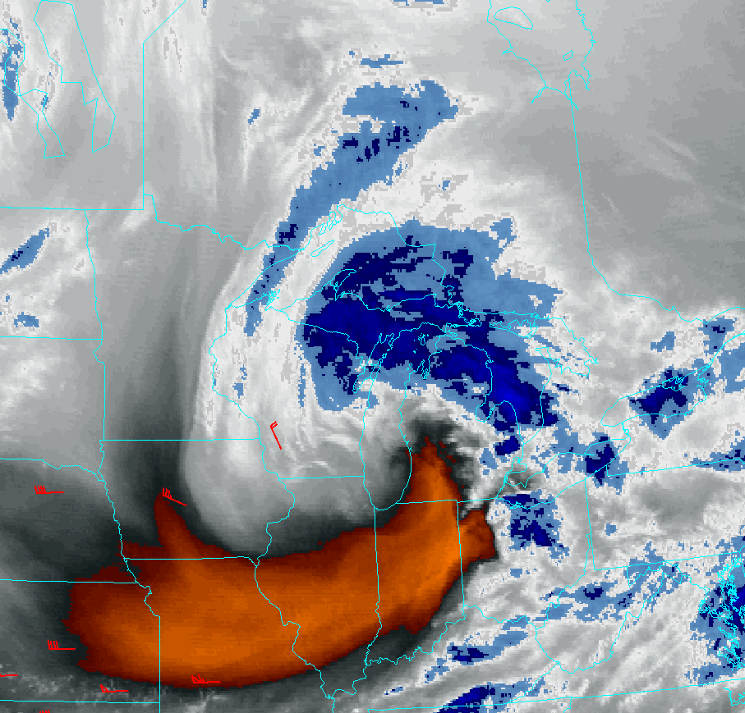
“The Event”
18Z 20Z 22Z 00Z 02Z 04Z
Local KAPX Radar/Water Vapor
Surface Map
-10c
0c
0c
-10c
96
L
10c
10c
10c
10c
Notes:
22z Surface mesoanalysis/Radar 2159z/WV image 2215z. Surface low into southern Lake Michigan…strong mesoscale band of precip spreading into northern Lower Michigan…thunder reported at HTL just ahead of 50+ dBZ radar returns (thundersnow…or is it?). High radar reflectivities due to bright banding. Dry slot progressing across southwest Lower Michigan.

Slide 22
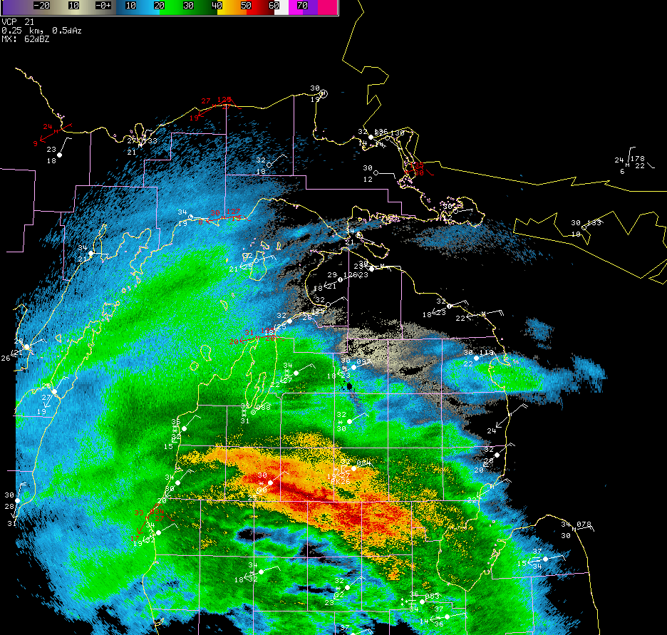
“The Event”
18Z 20Z 22Z 00Z 02Z 04Z
KAPX Reflectivity/Surface Observations
Notes:
Closer-in view of 2148z KAPX radar image plus surface observations. Reflectivity cross section next slide along dashed line.

Slide 23
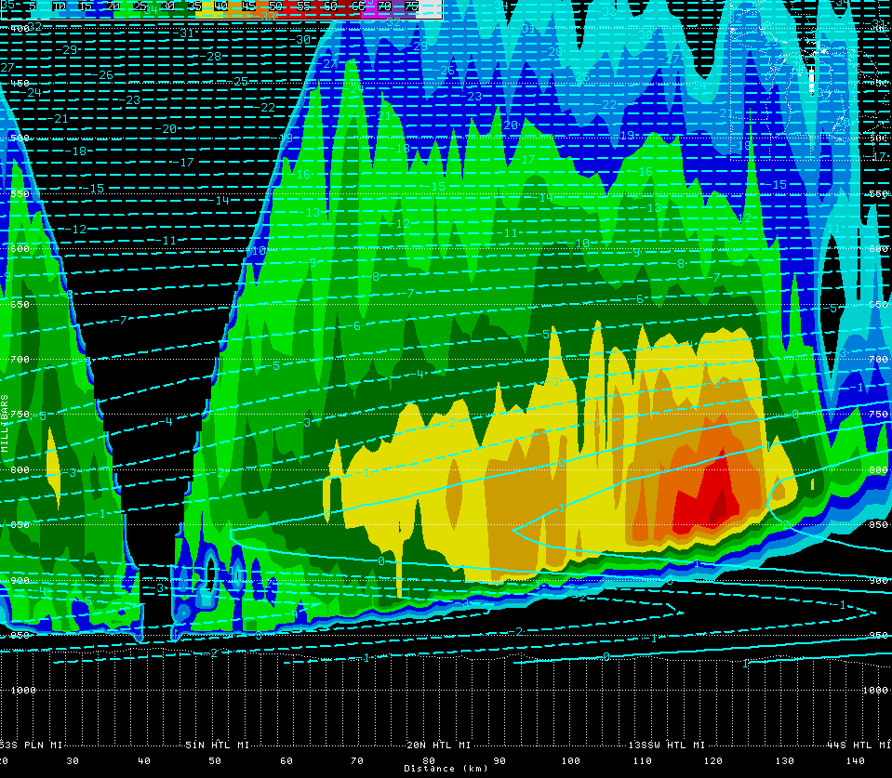
“The Event”
18Z 20Z 22Z 00Z 02Z 04Z
KAPX Reflectivity Cross Section/Temperatures
-10c
-10c
-5c
-5c
2-3c
0-1c
1-2c
KAPX
Radar
HTL
Notes:
KAPX Reflectivity cross section and GFS temperatures: 22z 8 Mar 09. Strong band of reflectivity in the vicinity of HTL likely due to some melting effects within shrinking elevated warm layer (wet/partially melted snowflakes?). Snow reported at HTL very likely ice pellets given thermal profile.

Slide 24
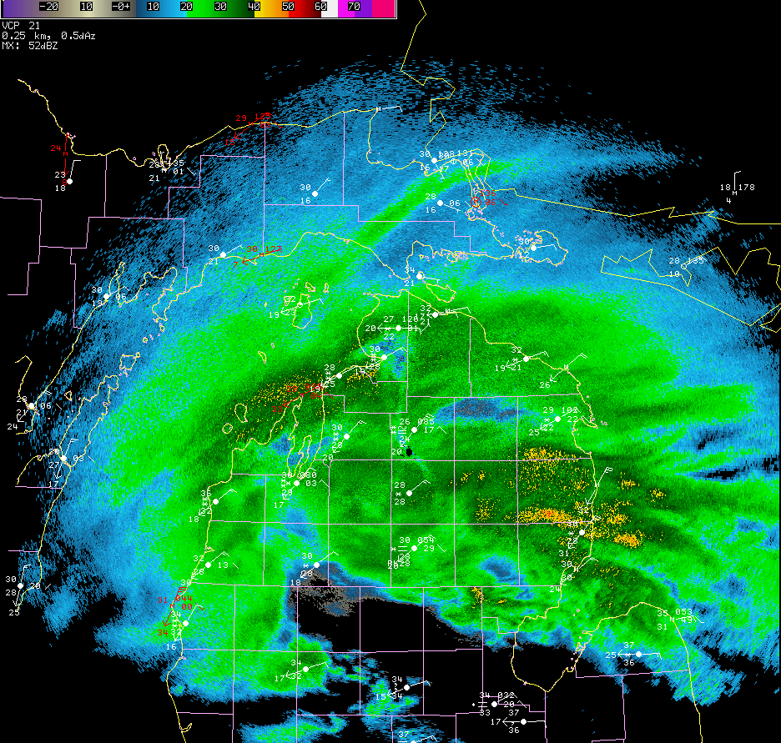
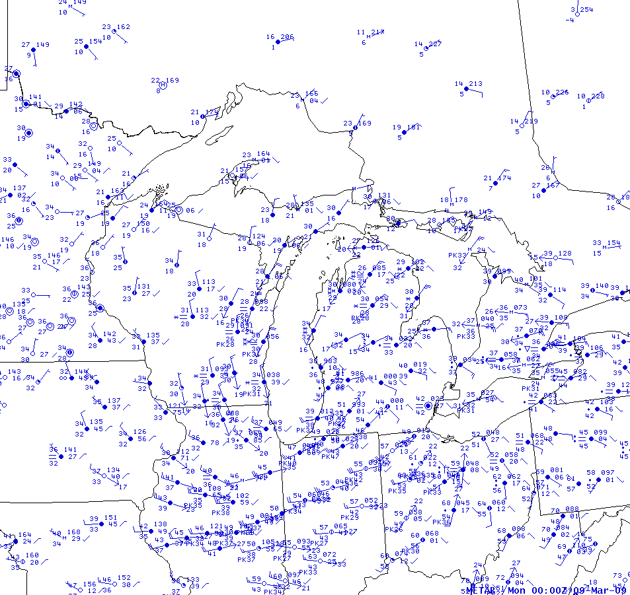
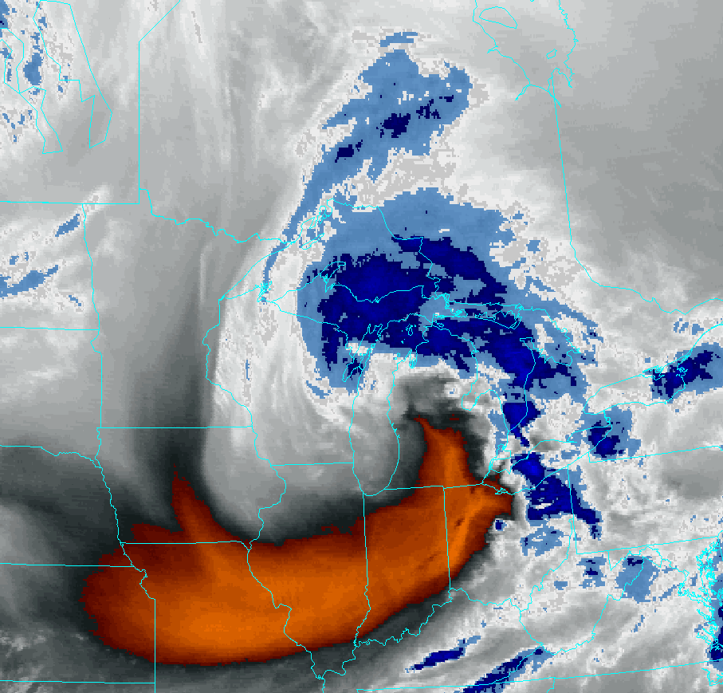
“The Event”
18Z 20Z 22Z 00Z 02Z 04Z
Local KAPX Radar/Water Vapor
Surface Map
-10c
0c
-10c
0c
95
L
10c
10c
10c
Notes:
00z Surface mesoanalysis/Radar 0024z/WV image 2315z. Precipitation has turned over to all snow across northern Michigan…heavy snowfall around northwest fringes of precip shield. Surface temperatures below freezing across most of northern Michigan.

Slide 25
“The Event”
18Z 20Z 22Z 00Z 02Z 04Z
KAPX Reflectivity/Surface Observations
Notes:
Closer-in view of 0024z KAPX radar image plus surface observations. Heavy snowfall along northwest portion of precip shield (patches of 40+ dBz).

Slide 26
“The Event”
18Z 20Z 22Z 00Z 02Z 04Z
MESOSCALE DISCUSSION 0215
NWS STORM PREDICTION CENTER NORMAN OK
0642 PM CDT SUN MAR 08 2009
AREAS AFFECTED...WI DOOR PENINSULA AND NRN LOWER MICH
CONCERNING...HEAVY SNOW
VALID 082342Z – 090245Z
HEAVY SNOWFALL RATES AROUND 1 INCH/HR ARE LIKELY OVER THE WI DOOR PENINSULA AND NRN LOWER MICH BEFORE ENDING W-E. THE HEAVIEST RATES WILL PROBABLY OCCUR IN THE 00Z-03Z PERIOD BEFORE GRADUALLY WEAKENING IN THE 03Z-06Z PERIOD.
SURFACE ANALYSIS SHOWS A 998MB LOW INVOF MKG AND THIS FEATURE IS FORECAST TO MOVE ENEWD AS A POTENT SHORTWAVE TROUGH LIFTS TO THE NE OVER THE GRT LAKES INTO ONTARIO DURING THE LATE EVENING/OVERNIGHT HRS. RADAR MOSAIC SHOWS A SW-NE ORIENTED REGION OF MODERATE SNOW WITHIN DEFORMATION ZONE. VIGOROUS UVV/S OVER AREA AS OF 00Z WILL QUICKLY MOVE NEWD IN ASSOCIATION WITH SYSTEM ACCORDING TO THE LATEST GUIDANCE...LEADING TO A DECREASING TREND IN LIFT/SUBSEQUENT DECLINE IN SNOWFALL RATES. NONETHELESS...HEAVY SNOWFALL RATES WILL LIKELY OCCUR DURING THE NEXT 1-2 HRS BEFORE CEASING ACROSS ERN WI...AND THEN END FROM W-E ACROSS NRN LOWER MICH IN THE 03Z-06Z PERIOD.
Notes:
Heavy snow got the attention of the mesoscale desk at the Storm Prediction Center.

Slide 27
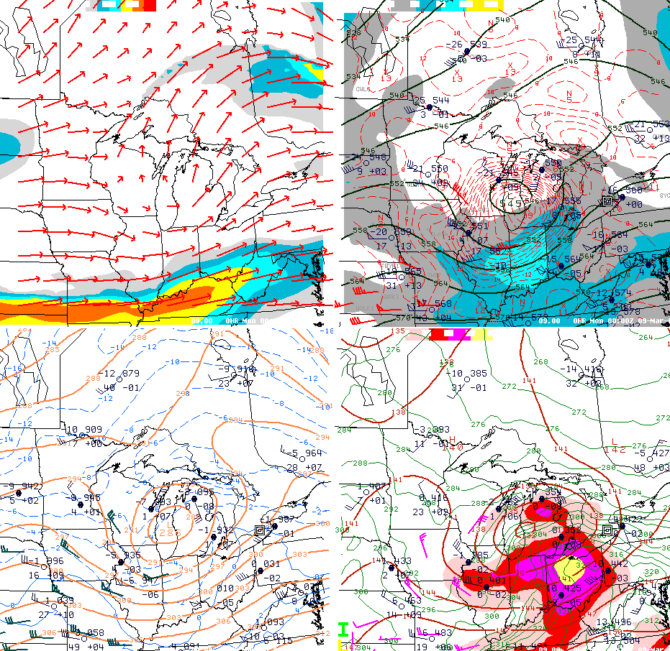
“The Event”
18Z 20Z 22Z 00Z 02Z 04Z
1.5 PVU Sfc Isotachs >80kt/Winds 500mb Height/Geostrophic Vort/Isotachs >40kt
“Col”
“Col”
700mb Height/Temperature 850mb Height/925-850mb Theta-e/Isotachs >30kt
Notes:
Four panel upper air analysis: 00z 9 Mar 2009. Top left--1.5 PVU surface isotachs/winds. Top right--500mb heights/geostrophic vorticity. Bottom left--700mb heights/temperatures. Bottom right-- 850mb heights/925-850mb theta-e/850mb isotachs. Strong low level warm/moisture advection punching into northern Lower Michigan along low level jet wrapping around north side of occluding low over central Lake Michigan. Col region in mid levels supportive of strong frontogenetic potential.

Slide 28
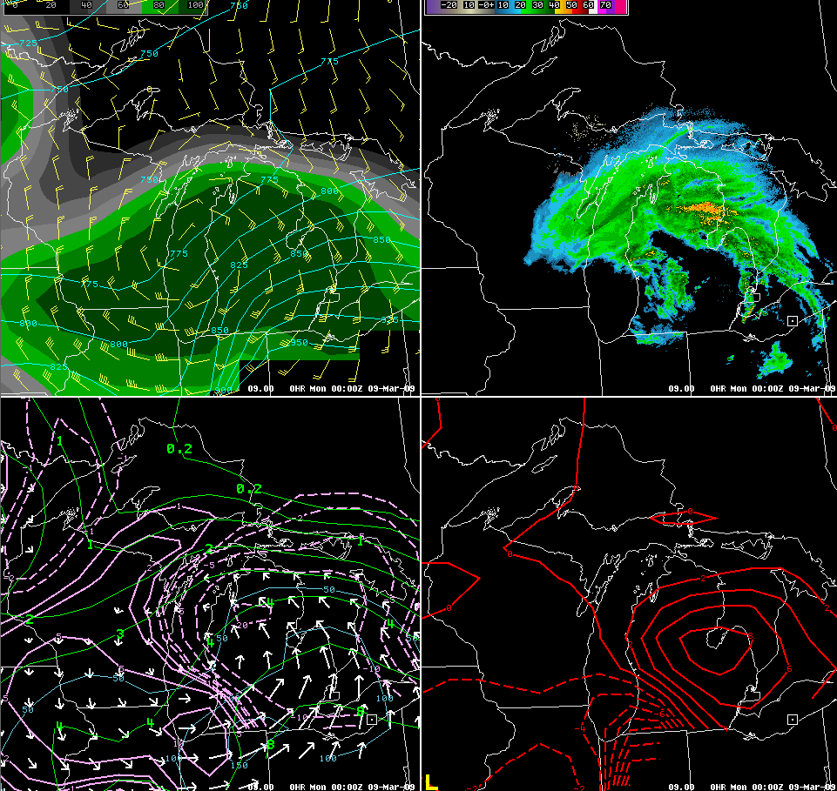
“The Event”
18Z 20Z 22Z 00Z 02Z 04Z
290K Pressure/Wind Barbs/RH (Green >70%) Radar Mosaic
290K Mixing Ratio/Moisture Convergence/Wind 290K Pressure Advection
Notes:
Four panel isentropic analysis (290K surface): 00z 9 Mar 2009. Strong moisture flux/convergence into northern Michigan feeding heavy snow band.

Slide 29
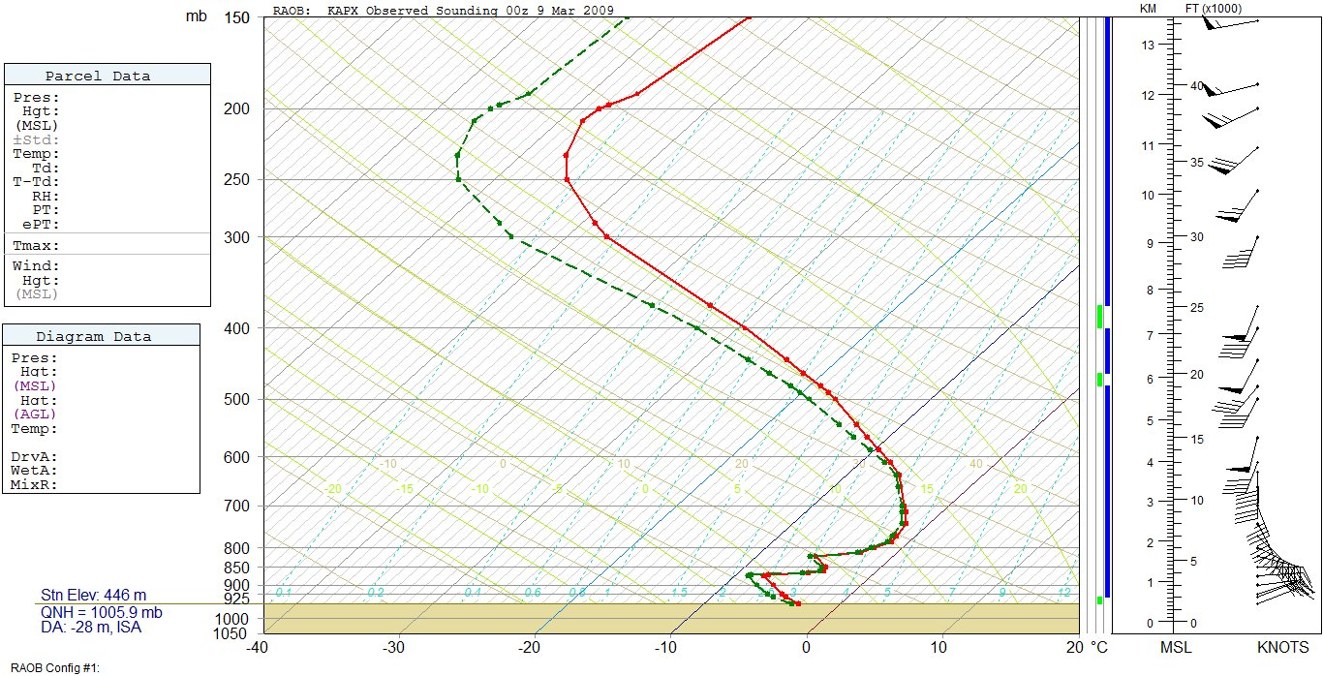
“The Event”
18Z 20Z 22Z 00Z 02Z 04Z
APX Observed Sounding: 00Z 9 Mar 2009
Red: Temperature
Green: Dew Point
Orange: Wet Bulb
0c
0c
Notes:
APX observed sounding: 00z 9 Mar 2009. Entire sounding below freezing…strong veering low/mid level hodograph indicative of strong warm advection.

Slide 30
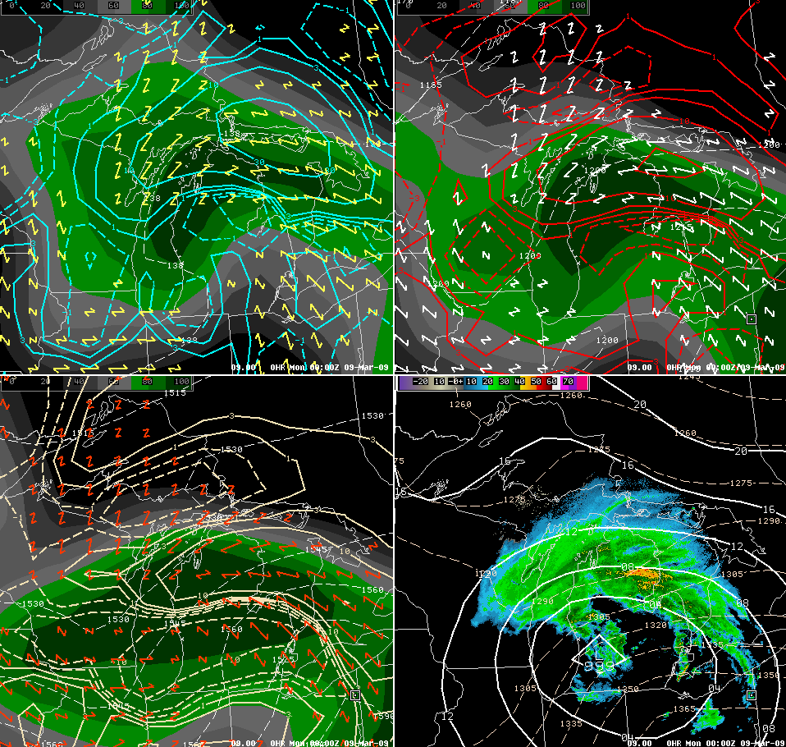
“The Event”
18Z 20Z 22Z 00Z 02Z 04Z
600-500mb F-gen/Deformation Vectors/RH 700-600mb F-gen/Deformation Vectors/RH
850-700mb F-gen/Deformation Vectors/RH MSLP/1000-850mb thickness/radar
Notes:
Four panel frontogenesis analysis: 00z 9 Mar 2009. Sloped frontogenesis across northern Michigan.

Slide 31
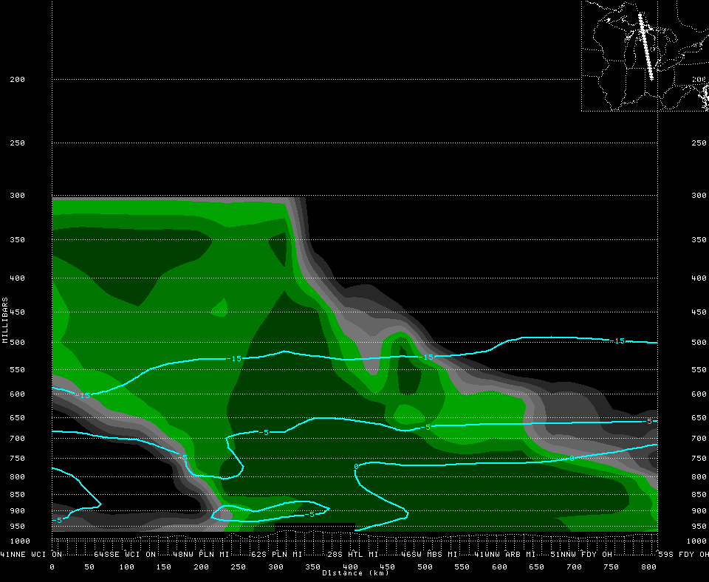
“The Event”
18Z 20Z 22Z 00Z 02Z 04Z
Cross Section: Relative Humidity (Green >70%)/0c, -5c, -15c Isotherms
Heavy Snow
Band
Dry Slot
PLN
GLR
HTL
N
S
Notes:
31

Slide 32
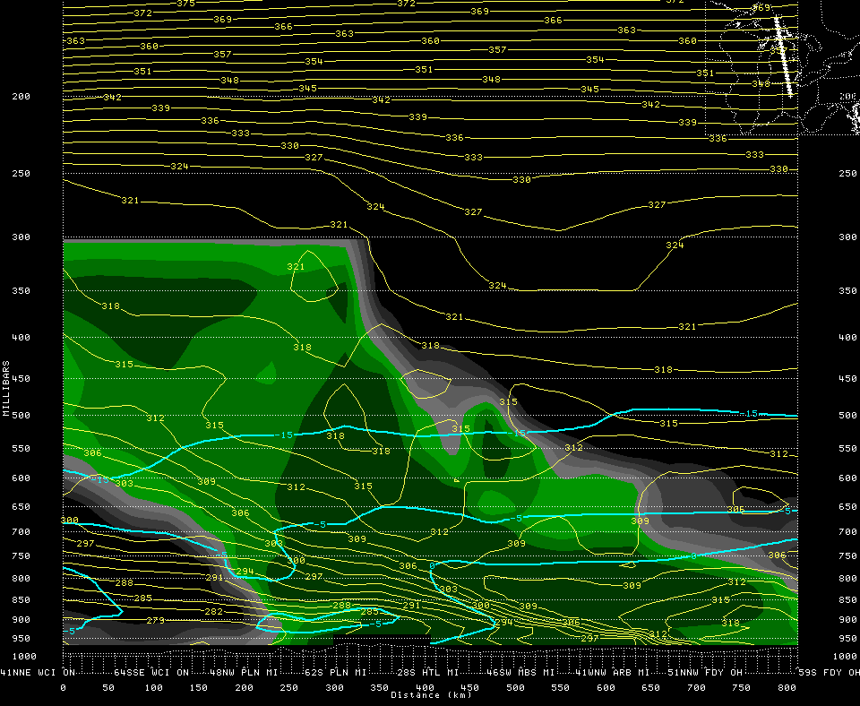
“The Event”
18Z 20Z 22Z 00Z 02Z 04Z
Cross Section: Relative Humidity (Green >70%)/Equiv Potl Temp (Yellow)
Heavy Snow
Band
Dry Slot
Weak Stability
Warm Frontal Zone
PLN
GLR
HTL
N
S
Notes:
32

Slide 33
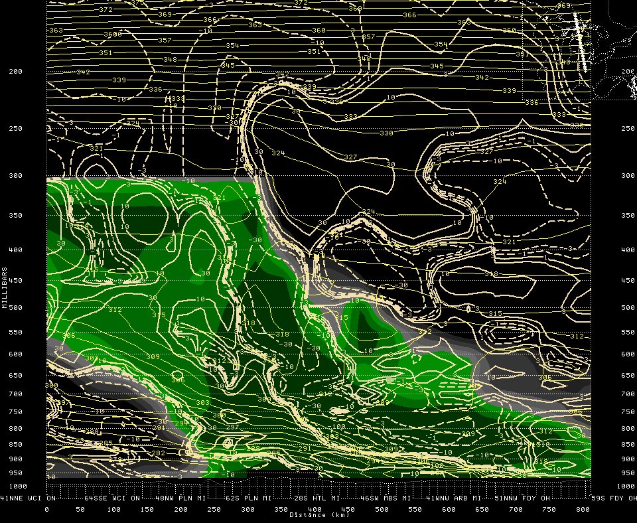
“The Event”
18Z 20Z 22Z 00Z 02Z 04Z
Cross Section: Relative Humidity (Green >70%)/Frontogenesis (Beige)
Heavy Snow
Band
Frontogenesis
Frontolysis
Warm Frontal Zone
PLN
GLR
HTL
N
S
Notes:
33

Slide 34
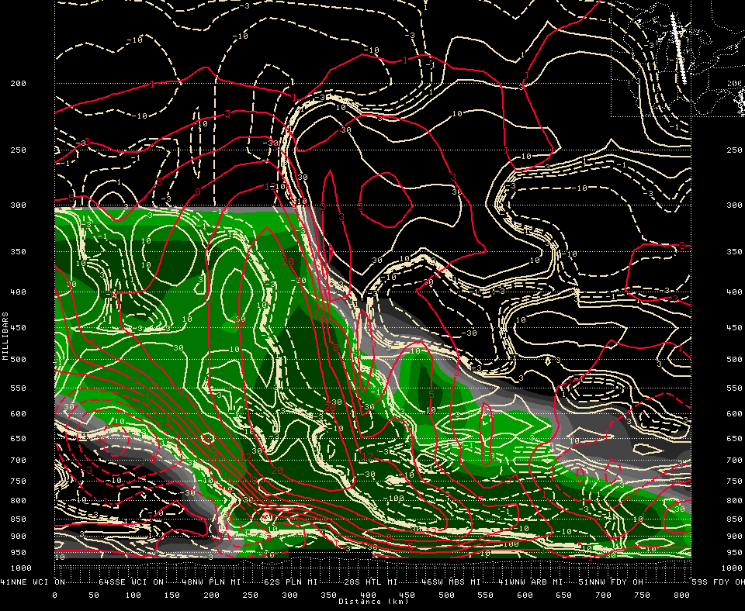
“The Event”
18Z 20Z 22Z 00Z 02Z 04Z
Cross Section: Frontogenesis/Omega (red solid=upward motion)
Heavy Snow
Band
-15c
-15c
PLN
GLR
HTL
N
S
Notes:
34

Slide 35
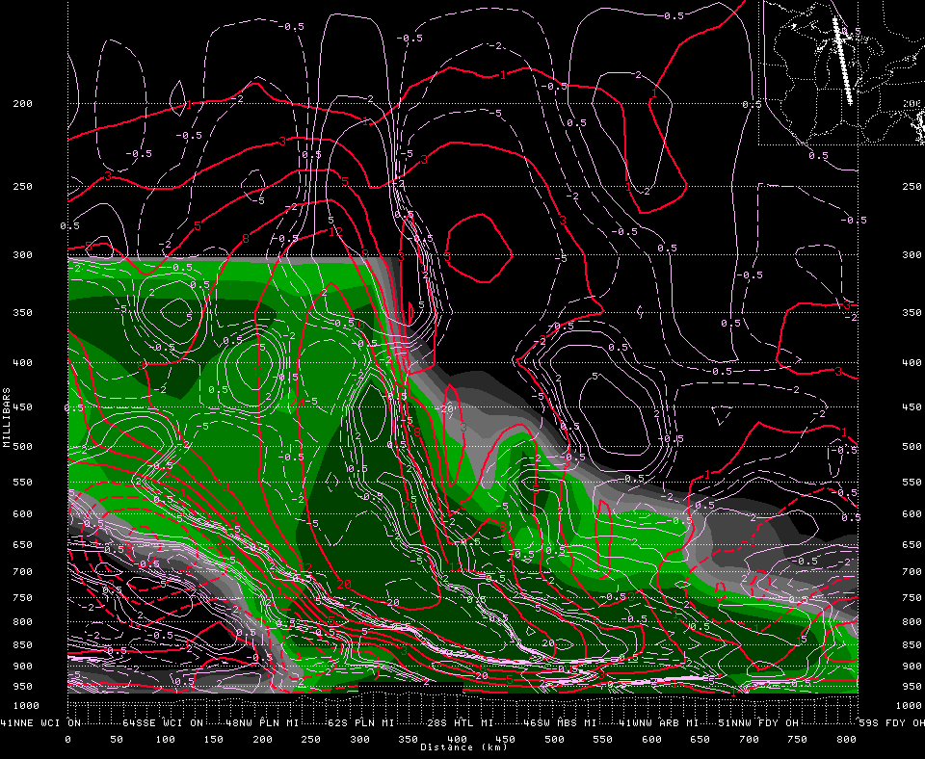
“The Event”
18Z 20Z 22Z 00Z 02Z 04Z
Cross Section: Omega/F-vector convergence (purple/dashed=convergence)
Heavy Snow
Band
-15c
-15c
PLN
GLR
HTL
N
S
Notes:
35

Slide 36
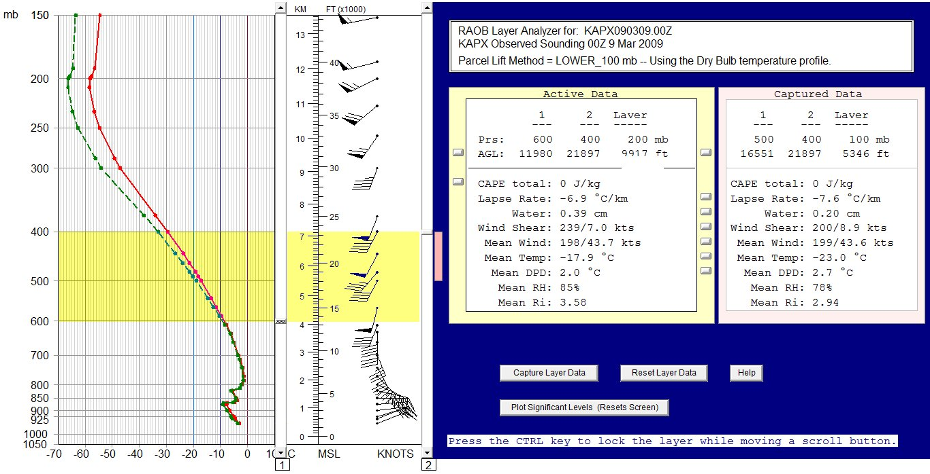
“The Event”
18Z 20Z 22Z 00Z 02Z 04Z
APX Observed Sounding Layer Analysis (600-500mb/500-400mb)
Red: Temperature
Green: Dew Point
Orange: Wet Bulb
0c
Notes:
APX observed sounding layer analysis. Steep lapse rates in mid levels…at these temperatures pretty much equal to the moist adiabatic lapse rate. Weak vertical wind shear in this layer as well…more supportive of upright convection rather than potential for slantwise convection (geostrophic momentum contours pretty much vertical).
36

Slide 37
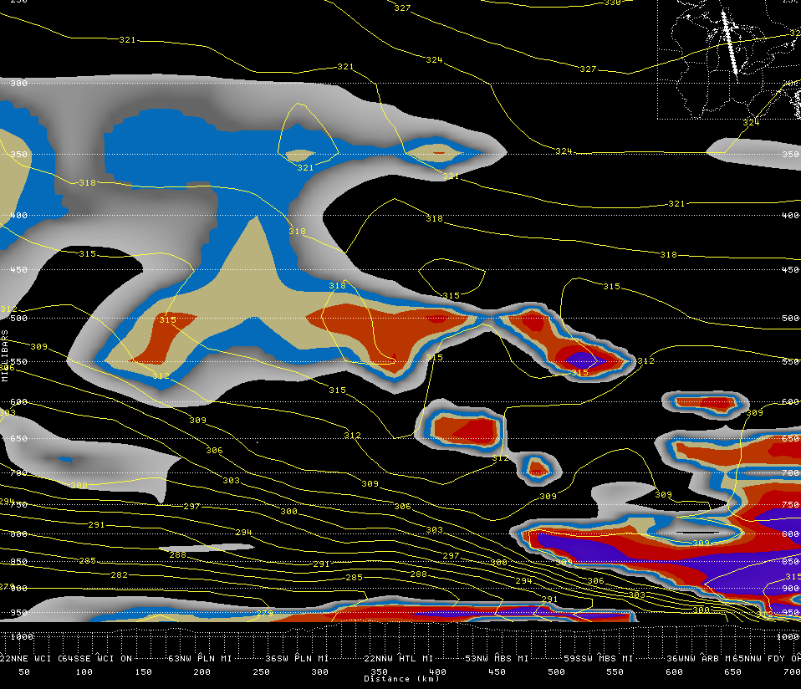
“The Event”
18Z 20Z 22Z 00Z 02Z 04Z
Cross Section: Equiv Potl Temp/Geostrophic Equiv Potential Vorticity < 0.25 (shaded)
Heavy Snow
Band
RH>80%
PLN
GLR
HTL
N
S
Notes:
37

Slide 38

“The Event”
Water Vapor/One Hour Lightning Distribution: 21Z 8 Mar 2009
Notes:
38

Slide 39

“The Event”
Water Vapor/One Hour Lightning Distribution: 22Z 8 Mar 2009
Notes:
39

Slide 40

“The Event”
Water Vapor/One Hour Lightning Distribution: 23Z 8 Mar 2009
Notes:
40

Slide 41

“The Event”
Water Vapor/One Hour Lightning Distribution: 00Z 9 Mar 2009
Notes:
41

Slide 42

“The Event”
Water Vapor/One Hour Lightning Distribution: 02Z 9 Mar 2009
Notes:
42

Slide 43

“The Event”
18Z 20Z 22Z 00Z 02Z 04Z
KAPX Reflectivity/Surface Observations
Notes:
Closer-in view of 0205z KAPX radar image plus surface observations. Heavy snowfall continues across far northern Lower Michigan.
43

Slide 44

“The Event”
18Z 20Z 22Z 00Z 02Z 04Z
KAPX Reflectivity/Surface Observations
Notes:
Closer-in view of 0345z KAPX radar image plus surface observations. Snowfall beginning to diminish in coverage, still some pockets of moderate/heavy snowfall across north central/northeast Lower Michigan.
44

Slide 45

“The Event”
KAPX Reflectivity Loop: 1901z 8 Mar -- 0457z 9 Mar 2009
Notes:
KAPX reflectivity loop ~1900Z 8 Mar - 0500Z 9 Mar.
45

Slide 46

The Aftermath
Summary
-- Quick hitting heavy snow event across northern Michigan, bringing snowfall amounts in excess of 12 in (30 cm).
-- Much of the snow fell in about a six hour time frame, with reported snowfall rates of 2-3 in (5-8 cm)/ hour.
-- Heavy snowfall driven by a well defined frontogenesis/frontolysis couplet within a mid level deformation axis around north side of strong short wave trough lifting northeast into the upper Great Lakes region, aided by weak stability above resultant frontal zone.
-- Cooling due to evaporation and melting eroded an initial elevated warm layer, allowing precipitation to change quickly over to heavy snow.
Notes:
46

